Slide 1

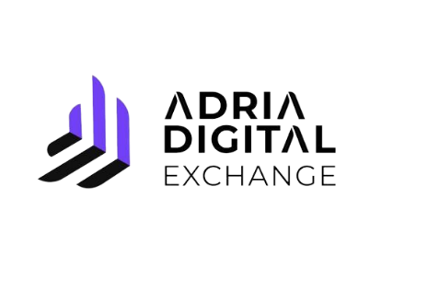
____________________________________________
Adria Digital Exchange – new digital asset platform
____________________________________________
Ohrid, 27.09.2023.

Slide 2
Regulation (That) Will Drive A Revolution
After a long period of debate, the EU has, in April 2023, approved the MiCA (Markets in Crypto Assets) regulation.
The goal – regulation of the blockchain sector and cryptoassets in the EU.
MiCA took effect in May in all EU states and will be applicable in the last quarter of 2024.
MiCA sets clear requirements for the authorisation and management of custodians and cryptocurrency service providers in the EU, to ensure the protection of customers' assets.
Particular focus - investor protection, market integrity, legal security and promotion of innovation.
Regulation – a step in the digital revolution of the sector and a positive sign for the market and investors.

Slide 3
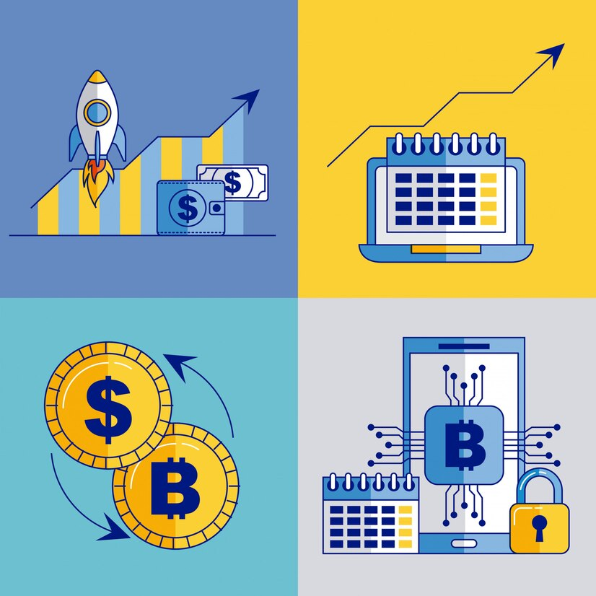
Regulation As An Opportunity
MiCA - traditional financial institutions are now enabled to operate directly with crypto assets.
Zagreb Stock Exchange – great experience of a regulated capital market.
MiCA = Opportunity!

Slide 4
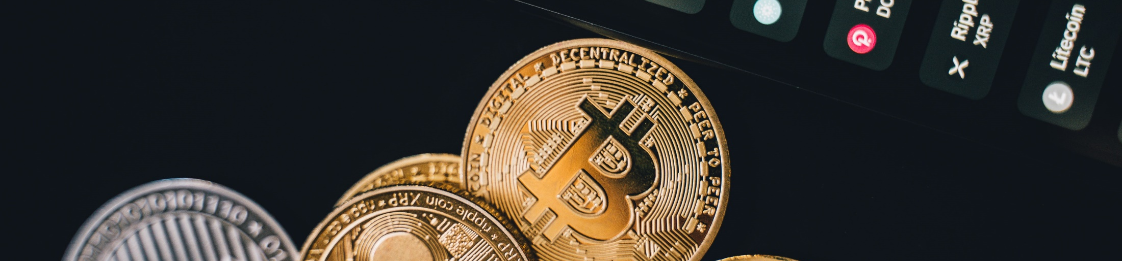
Market Analysis And Client Interest
In 2021, Croatian cryptocurrency OTC exchanges had a total turnover of 302 million EUR.
This was 40 million euros more than the trading of securties on Zagreb Stock Exchange!
A survey among members of the Zagreb and Ljubljana Stock Exchanges showed that there is significant interest among members and their clients in trading with crypto assets.
Regulation/Opportunity + Interest = Plan for action.

Slide 5

Step One – Finding A Strategic Partner
Digital Assembly - a Croatian IT company with extensive experience in the fintech industry.
The company provides professional IT and blockchain services for business entities, organizations, and financial institutions.
Since its inception, their focus has been on combining traditional financial products with blockchain technology.
Through various projects, they have gained rich knowledge and experience with trading platforms (MTF & UTP), inclusion and custody of financial instruments, algorithmic trading, issuance of digital currencies, and other auxiliary procedures (AML, security and risk management).

Slide 6
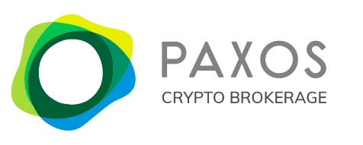
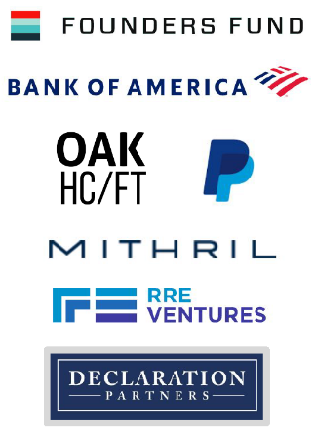
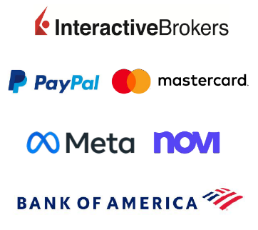
Paxos – general information
Step Two – Finding A Trading Service Provider
Incorporated in
2012.
240+ employees
Capital
Volume
Raised $+540m through 4 funding rounds
$18 billion worth of assets under custody
Solutions for the largest global fintech companies and financial institutions
2015. New York Department of Financial Services grants „Trust Charter” status –
Making Paxos the first and most regulated cryptocurrency exchange in the US
3 global offices – New York, London and Singapore
Paxos' products and services are available to 180 countries and territories with 24-hour support.

Slide 7
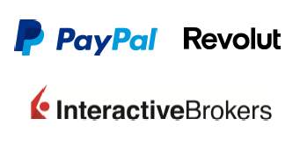

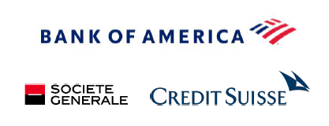

Leader in Crypto Infrastructure
Crypto
Cash
Securities
Commodities
2012.
itBit go-live, first regulated crypto exchange
Today
Paxos Crypto Brokerage is a leading provider of crypto infrastructure, offering licensing, custody, and trading platform for millions of users through PayPal, Interactive Brokers, and many other platforms.
$+55b
In transaction
2018.
Paxos issued the first regulated stablecoin, with a 1:1 basis in USD and USD cash equivalents (US-T bills).
Today
Paxos is a leading issuer of stablecoins - USDP and BUSD.
$+45b
Stablecoin issued
2020.
Paxos settled the transaction of tokenized stocks between Instinet Nomura and Credit Suisse - the first transaction settled outside of NSCC in 40 years.
Today
CA-1 filing has been submitted to the SEC
150+ settlements daily
2019.
Paxos has launched a fully regulated token based on gold to enable tokenized settlement of commodities.
Today
PAX Gold is a fully regulated gold-backed token with a market capitalization.
$+330m in tokenized gold

Slide 8

Why Digital Assembly and why Paxos
One-stop solution
Low-cost entry in crypto
Risk sharing
Digital Assembly’s offer is complete in scope with development & maintenance and hosting, SLA & SOC included.
Partnering with DA offers
risk sharing.
Partnering with DA ZSE will
build and maintain fully operating crypto trading platform for a small cost.
Compliant with regulations
Safeguarding
Potential
Paxos is dedicated to be fully regulated by EU regulations.
High level of safeguarding for assets.
High daily trading volumes, competitive pricing, potential for developing new products and services.

Slide 9
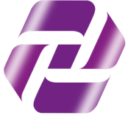
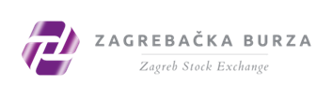


Adria Digital Exchange
The infrastructure built by the Zagreb Stock Exchange and Digital Assembly will enable trading of crypto assets in a safe and transparent manner.
Adria Digital Exchange
Digital
Assembly
ADE will enable members of ZSE, members of other exchanges, as well as third-party interested parties and their clients to access global crypto markets.
Paxos - provider of trading, custody, and settlement services for crypto assets and money.
Adria Digital Exchange

Slide 10

ADE Infrastructure
Adria Digital Exchange
Crypto Platform
Member 1
ADE Trading Platform
(front end developed by ADE)
Crypto Exchange
ADE corporate fiat account
ADE omnibus account
Member 2
API
fiat account
Crypto account
Data Warehouse
Auxiliary account
Accounting
Brokeri
1 saldo
Brokeri
2 salda
Brokeri
3 salda
Member 3
Reporting
Fiat: FBO banking account
Reconciliation
Crypto: FBO Wallets (Cold, Warm, Hot)
WHO
PARTNERS
TRADING AND SETTLEMENT
Investment company
Credit institution
A company registered to provide the service of receiving and transferring orders for digital assets on behalf of third parties
Zagreb Stock Exchange
Digital Assembly
Paxos

Slide 11
Adria Digital Exchange – General Information
Simple integration
Trading crypto assets
Other opportunites
Members have access to a plug & play solution for trading crypto assets.
Members connect to the ADE platform through the ADE front-end (TWS) or through ADE APIs.
When end-user funds are settled in the service provider's account, they are immediately available for trading on the ADE platform.
Members and their clients will have a secure, transparent, and cost-effective access to crypto assets.
ADE will initially offer trading with 5 types of crypto assets (BTC, BCH, ETH, LTC, PAXG).
Real-time trade data and order book.
Expanding the offering of crypto assets, accessing other options from the service provider's platform - trading of tokenized stocks, commodities, margin trading, futures, etc.
Possible access to investment, lending, and other 3rd party protocols upon regulatory approval.

Slide 12






ADE offers its members a range of benefits
Benefit…
…implies responsibility
Quick and cost-effective access to the crypto market.
Collecting KYC information from investors.
New revenue stream
Accounting and asset management of end investors¹
New client acquisition
Starting from 2024, the minimum required capital will be 50,000 € (MiCA)
Members will have the option to perform accounting through the ADE platform, in case they do not opt for developing internal databases. Management of end-user assets involves receiving and transferring user funds to the ADE corporate bank account and withdrawing funds from the ADE platform to end-users when they withdraw their assets.

Slide 13
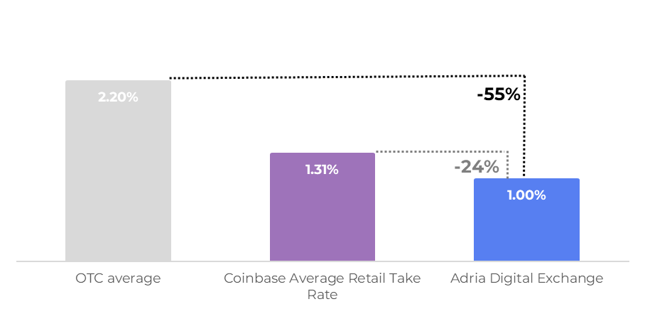



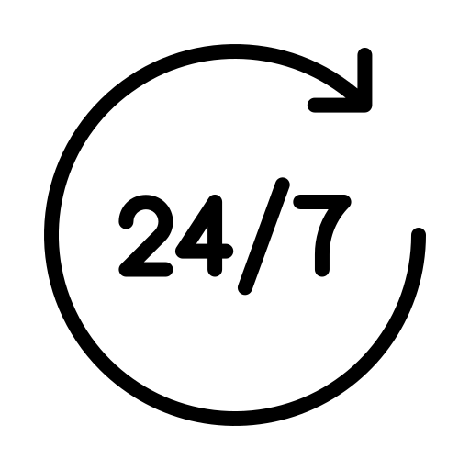

Advantages of ADE platform for investors
Adria Digital Exchange offers lower trading costs compared to OTC and major global market platforms.
High-quality service at a reasonable price
Diversification potential
Trust and security of the ZSE brand
24/7 access to ADE trading platform
Source: Electrocoin, Bitcoin Store, Kraken, Coinbase, ZSE Management.

Slide 14

















IT Security of ADE Platform
Adria Digital Exchange – existing Security Operations Center (SOC)
INTERNET
OVIRT LAYER
PHYSICAL LAYER
Traders
FreeIPA
Elastic Stack
HashiCorp Vault
IPS Network Firewall
IPS/IDS Snort
Netapp Storage
Netapp DR Storage box
CLOUDFLARE
Wazuh
OpenSCAP
Zabbix Monitoring
Public DNS
DDoS Protection
NGINX Ingress Proxy
NGINX Ingress Proxy
OKD Platform
Blade Chasis
Blade Chasis
StackRox
KeyCloak SSO
Frontend
Business
Database

Slide 15
Custody Insurance
Fiat Assets
Crypto Assets
Under NY Banking Law and by virtue of our Trust charter with NYDFS regulatory oversight, Paxos Trust Company LLC is a qualified custodian of fiat and digital assets.
In the unlikely event of Paxos Trust’s insolvency, NY Banking Law protects customer assets from being used to satisfy the debt of Paxos Trust. All assets are held bankruptcy remote in segregated accounts.
Trust company does not lend out customer assets. All customer assets remain in Paxos Trust’s custody.
Paxos utilizes numerous insured depository institutions to custody fiat balances.
Private uninsured deposit insurance protects customers in case of unexpected failure.
Cold Wallet – offline; Physically secure location; industry-leading insurance.
Hot Wallet – Multy-Party Computation signing; Capped value in wallet; industry-leading insurance.
Insurance (CW* - $300m; HW** - $10m)
Arch Capital Group (Lead), QBE, Hamilton Insurance Group, Liberty Mutual Group & HDI Global, Sompo International (Lead) & Aspen Insurance Holdings.
*CW - Cold Wallet
**HW- Hot Wallet

Slide 16

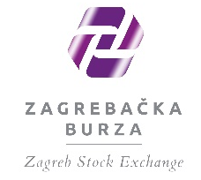
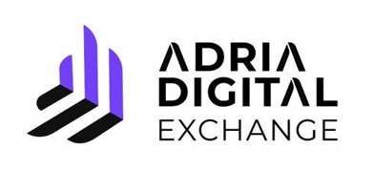
Our vision: Alliance for trusted crypto trading in CSEE

